Slide 1
Daviteq Technologies Inc
COMPANY PROFILE

Slide 2
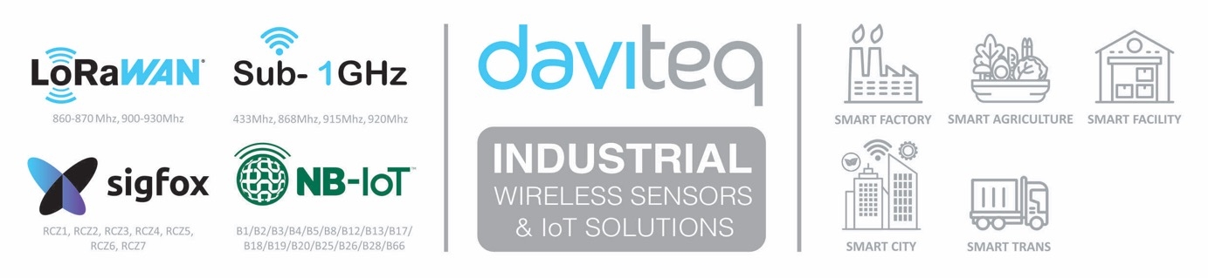
What we do?
We design & manufacture
Smart Wireless IoT Sensors, IoT gateway, IoT solutions
for different vertical applications
Confidential - Copyright by Daviteq - 2021

Slide 3
Figure Facts
> 16 years
Experiences in Process Instruments & Controls
> 10 years
In developing and manufacturing Industrial Sensors
< 3 weeks
To develop a new sensor
> 90
Product types have been developed
> 30
IoT solutions have been deployed
> 50,000
Products have been sold
> 20
Solution Partners in Vietnam
> 30
Solution Partners in other countries
> 150
Industrial Customers in Vietnam
Confidential - Copyright by Daviteq - 2021

Slide 4
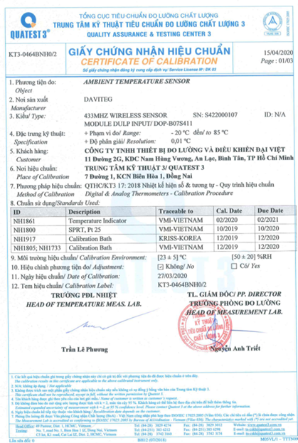
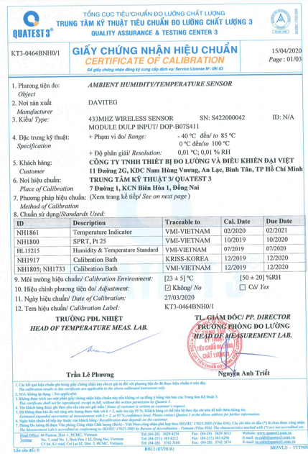
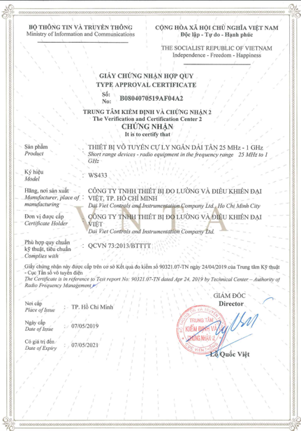
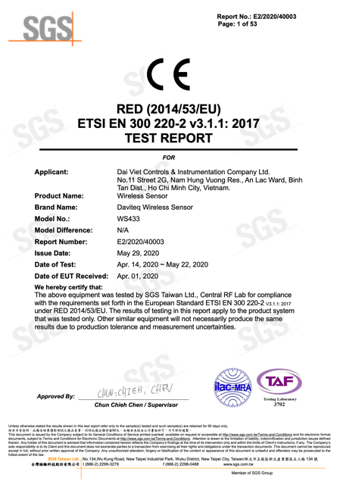
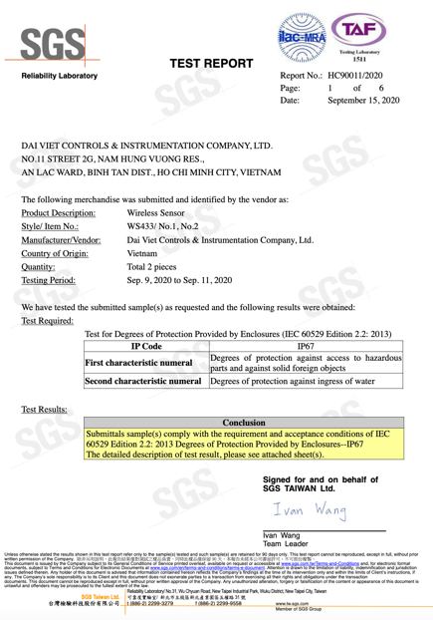
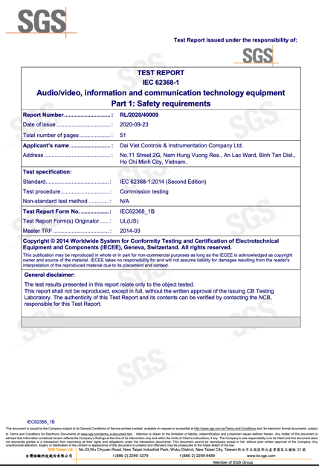
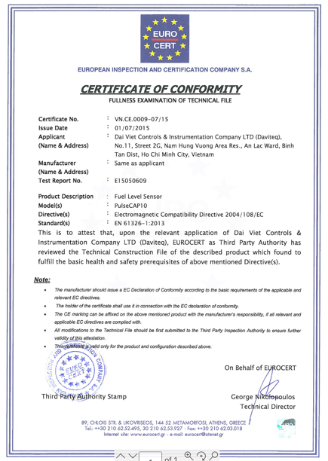
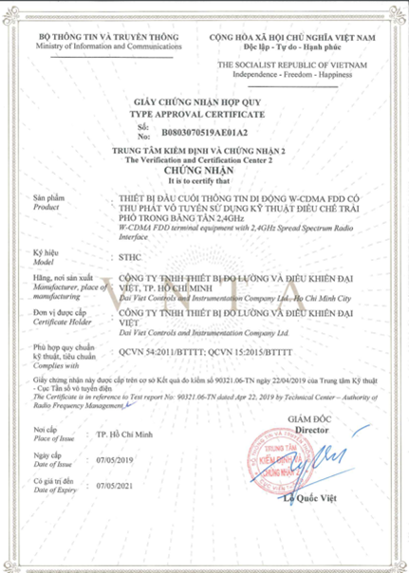
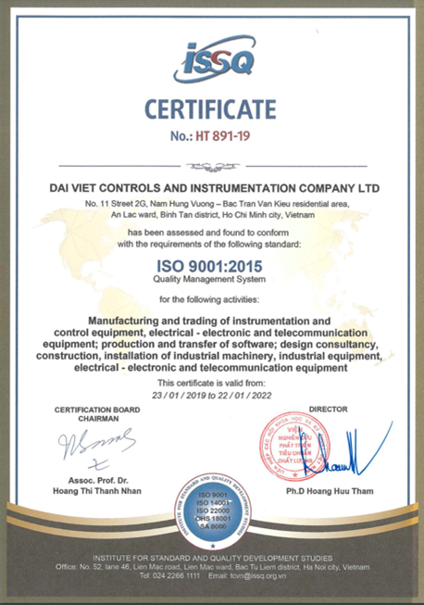
Certifications
Certificate for Wireless Sensors
Certificate for Fuel Level Sensors
Certificate for IoT Gateway
Certificate for Daviteq
Confidential - Copyright by Daviteq - 2021

Slide 5
Daviteq Milestones
Launch PulseCAP 10 in Vietnam
Start Develop IoT Platform
Start Export
Daviteq established
2009:
Start R&D
First IoT Product launched
Develop Wireless Sensors
2004
2004
2006
2008
2010
2012
2014
2016
2018
2020
2206 days
1st 5-year was a Trading Company in Process Instruments and Controls
Continuous Product Development
Market leader Vietnam
for Wireless Sensors & IIoT Solutions
R&D
Confidential - Copyright by Daviteq - 2021

Slide 6
Daviteq Milestones
09-2004: Company Registered (as shown in business license)
07-2006: Official operating with trading activities, distributing Process Instruments & Controls products from famouse brands Emerson, Yokogawa, Magnetrol, Opto22, Crane, Komoto;
2009: The 1st Hardware R&D team was formed to develop Sensors;
2010: The 1st product – Fuel Level Sensor PulseCAP10 was introduced to Vietnam market, for Transportation Industry;
2012: Started exporting PulseCAP10 fuel level sensors to Oversea markets;
2012: The Software R&D team was formed to start develop the Connected Platform (the fomerly name of IoT Platform Globiots);
2014: The first IoT solutions was installed for customer, a Coffee factory, to monitor the Steam & Boiler water quality;
2017: Started developing and manufacturing the Wireless Sensors using Sub-GHz technology from Texas Instruments;
2018: Started developing and manufacturing the LoRaWAN Wireless Sensors;
2019: Started developing and manufacturing the Sigfox Wireless Sensors;
R&D
Confidential - Copyright by Daviteq - 2021

Slide 7
Daviteq – business details
Company Name : Daviteq Technologies Inc
Registered trademark : Daviteq, Globiots
Type : Incorporation
Established : 09-2004 (operated since 07-2006)
Nature of Business : Developing & Manufacturing Wireless Sensors & IoT Products, Solutions
Labor : 30-50 people. R&D: 10.
Registered Capital : ~ 1M USD
Production Capacity : > 50.000 products / year
Quality standard : ISO9001-2015
Other Certificates : CE Mark, EMC Test report, Safety Test Report…
The leading company in Vietnam to develop and manufacture sensor & controls products :
  Wireless IoT Sensors
  Industrial IoT Gateway, Platform and Solutions
  Smart fuel level sensor for Transportation Industry
  Exporting to countries: Australia, New Zealand, Malaysia, Singapore, Philippines, India, Indonesia, UK, Normay…
Confidential - Copyright by Daviteq - 2021
Notes:
Nhấn mạnh: KINH NGHIỆM 10 NĂM VỀ ĐO LƯỜNG & ĐIỀU KHIỂN, ĐỘI NGŨ TRÊN 40 NGƯỜI, TRÊN 10 NGƯỜI LÀM R&D, TỰ PHÁT TRIỂN & SX THIẾT BỊ CUNG CẤP TRONG NƯỚC & XUẤT KHẨU

Slide 8
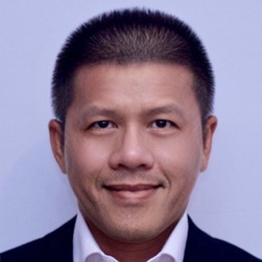
Contact Information
Company name (Vietnamese) : Công ty Cổ Phần Công nghệ Daviteq
Company name (English) : Daviteq Technologies Inc
VAT Code : 0303507984
Registered Address (for issuing Invoice) : No. 91-93 Street 5, An Phu Ward, District 2, Ho
Chi Minh City, Vietnam
Operating Office Address : No.11 Street 2G, Nam Hung Vuong Res., An Lac
Ward, Binh Tan Dist., Ho Chi Minh City, Vietnam.
Representative : Mr. Nguyen Vinh Loc – President & CEO
Tel : +84-28-62682523/24
Email : info@daviteq.com
Websites : https://www.daviteq.com
Confidential - Copyright by Daviteq - 2021
Notes:
Nhấn mạnh: KINH NGHIỆM 10 NĂM VỀ ĐO LƯỜNG & ĐIỀU KHIỂN, ĐỘI NGŨ TRÊN 40 NGƯỜI, TRÊN 10 NGƯỜI LÀM R&D, TỰ PHÁT TRIỂN & SX THIẾT BỊ CUNG CẤP TRONG NƯỚC & XUẤT KHẨU

Slide 9
Daviteq Mission
Our Mission
Develop and manufacture state of the art and high-quality products to improve the efficiency customer’s business.
Our Values
- Produce products that are above customer’s expectation;
- Our customers success is our target;
- Create an inspiring work environment for every Daviteq employee
- Sustainable development to build better life for everyone;
Operation Philosophy
Planning our development;
Discipline in actions;
Creative in solutions
Flexible in issues;
Responsible in business;
Confidential - Copyright by Daviteq - 2021
Notes:
Nhấn mạnh: KINH NGHIỆM 10 NĂM VỀ ĐO LƯỜNG & ĐIỀU KHIỂN, ĐỘI NGŨ TRÊN 40 NGƯỜI, TRÊN 10 NGƯỜI LÀM R&D, TỰ PHÁT TRIỂN & SX THIẾT BỊ CUNG CẤP TRONG NƯỚC & XUẤT KHẨU

Slide 10
Why Daviteq?
17-year experience in Industrial Measurement and Controls;
10-year experience in Developing and Manufacturing instruments, IoT wireless sensors, IoT gateways & IoT solutions;
In-house product developing capability from Hardware, Firmware, Software (Server back-end, Web, Mobile);
Product to comply International standard: CE, EMC…
Core technology: Ultra-low power wireless sensors (single battery can last 10-15 years);
Core technology: Support various open connectivities: LoRaWAN, Sigfox, Sub-GHz, NB-IoT…
Core technology: NO-CODE IoT Platform for quick deployment any IoT Solutions;
Worldwide markets: Vietnam, Singapore, Malaysia, Australia, New Zealand, India, South African, Europe…
Confidential - Copyright by Daviteq - 2021
Notes:
Nhấn mạnh: KINH NGHIỆM 10 NĂM VỀ ĐO LƯỜNG & ĐIỀU KHIỂN, ĐỘI NGŨ TRÊN 40 NGƯỜI, TRÊN 10 NGƯỜI LÀM R&D, TỰ PHÁT TRIỂN & SX THIẾT BỊ CUNG CẤP TRONG NƯỚC & XUẤT KHẨU

Slide 11
Key Markets
SMART MANUFACTURING
FACILITY MONITORING
SMART CITY
TRANSPORTATION / LOGISTIC
UTILITIES
Confidential - Copyright by Daviteq - 2021
Notes:
Nhấn mạnh: KINH NGHIỆM 10 NĂM VỀ ĐO LƯỜNG & ĐIỀU KHIỂN, ĐỘI NGŨ TRÊN 40 NGƯỜI, TRÊN 10 NGƯỜI LÀM R&D, TỰ PHÁT TRIỂN & SX THIẾT BỊ CUNG CẤP TRONG NƯỚC & XUẤT KHẨU

Slide 12
Business Model
What Products / Services to be supplied:
Selling Hardware
Sensors,
Gateway,
Server,
Accessories…
(Daviteq Brand and Other brands)
Selling Software
Annual Subscription
+
On-premise + Annual Maintenance
Selling Engineering
For Projects
Design
Installation
Configuration
Documentation
…
Selling Software Customiza-tion
Develop based on the existing software core
Confidential - Copyright by Daviteq - 2021
Notes:
Nhấn mạnh: KINH NGHIỆM 10 NĂM VỀ ĐO LƯỜNG & ĐIỀU KHIỂN, ĐỘI NGŨ TRÊN 40 NGƯỜI, TRÊN 10 NGƯỜI LÀM R&D, TỰ PHÁT TRIỂN & SX THIẾT BỊ CUNG CẤP TRONG NƯỚC & XUẤT KHẨU

Slide 13












Serving different kinds of Industry
Confidential - Copyright by Daviteq - 2021

Slide 14
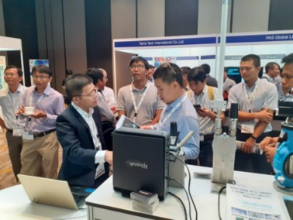
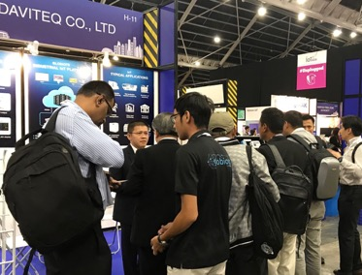
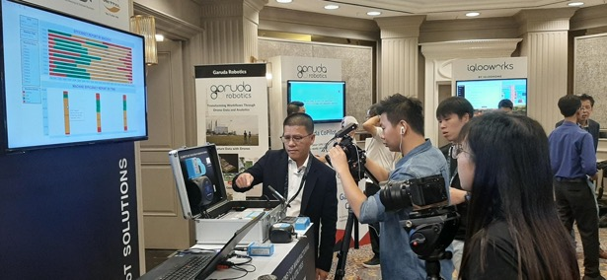
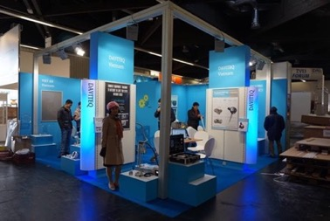
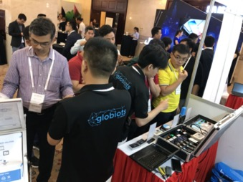
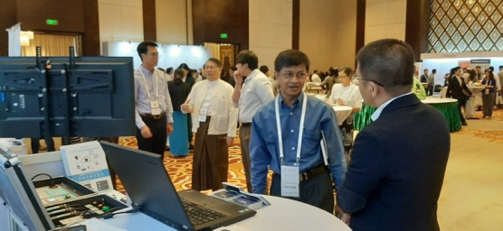
Our activities
Daviteq at ISA Vietnam 2019
Daviteq at IoT Asia 2019, Singapore
Daviteq at GSMA 360 2019, Kuala Lumpur
Daviteq at Exhibitions in Nurnberg,
Germany 2015
Daviteq at Asia IoT Business Platform 2019, Vietnam
Daviteq at Asia IoT Business Platform 2019, Myanmar
Confidential - Copyright by Daviteq - 2021

Slide 15
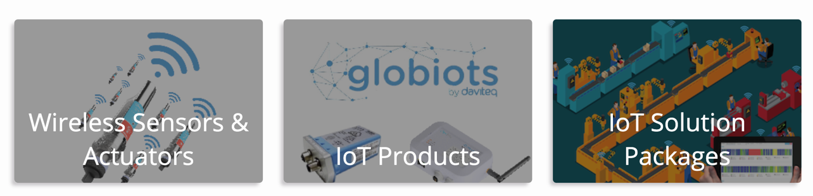
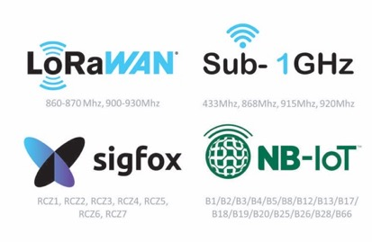
Daviteq Strategic Products
Confidential - Copyright by Daviteq - 2021
Notes:
CÁC LỢI ÍCH KHI KIỂM SOÁT TỐT NĂNG LƯỢNG

Slide 16
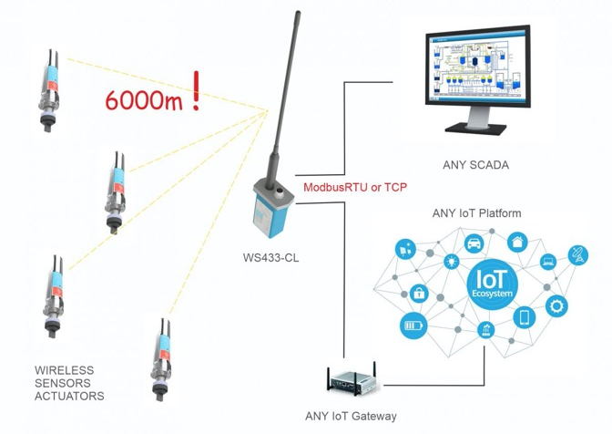
Daviteq Wireless Sub-GHz Sensors & Actuators
Daviteq Sub-GHz Wireless Sensors
Long Distance communication
1000m LOS or go through 4 floors
Up to 15-year Battery life
by popular battery Alkaline or Lithium
2-way communication
For strong functions, Configuration on Air
CE/RED Certified
EMC, Safety and IP67 test reports by SGS
Many kinds of Sensors and I/O
Temperature, humidity, pressure, level, analog, digital, ambient ligth, vibration, gas sensor, liquid sensor…
1
Confidential - Copyright by Daviteq - 2021
Notes:
CÁC LỢI ÍCH KHI KIỂM SOÁT TỐT NĂNG LƯỢNG

Slide 17
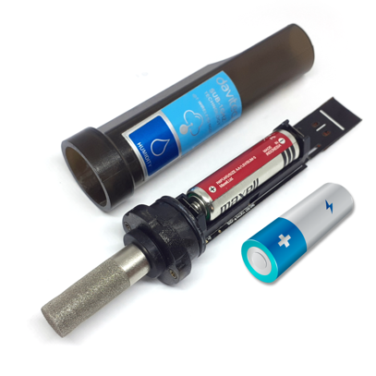
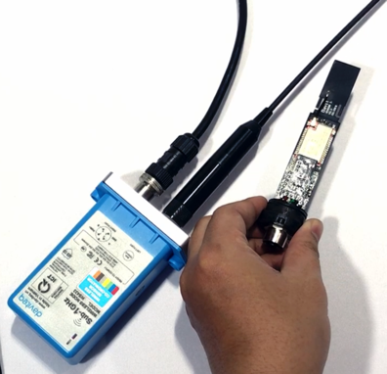
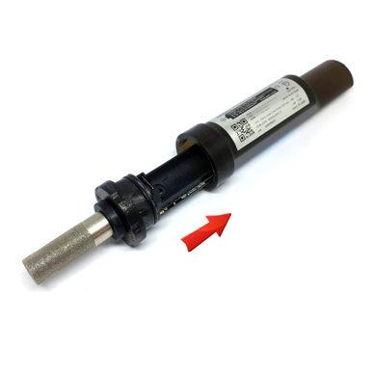
Daviteq Wireless Sub-GHz – Easy of Use
Open cover by 1 screw
Insert Battery AA 1.5V
Place sensor nearby Wireless Co-ordinator to add it in
Confidential - Copyright by Daviteq - 2021
Notes:
CÁC LỢI ÍCH KHI KIỂM SOÁT TỐT NĂNG LƯỢNG

Slide 18
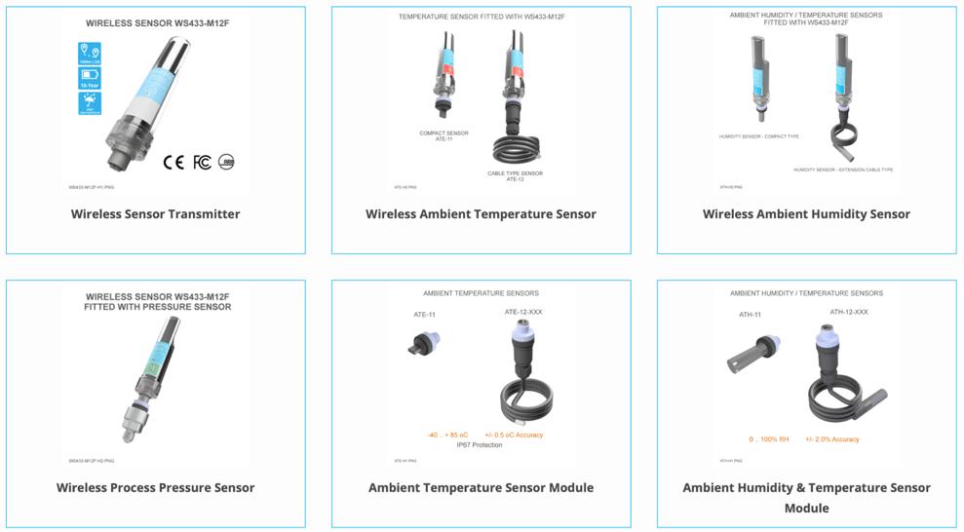
Daviteq Wireless Sub-GHz Sensors & Actuators
Confidential - Copyright by Daviteq - 2021
Notes:
CÁC LỢI ÍCH KHI KIỂM SOÁT TỐT NĂNG LƯỢNG

Slide 19
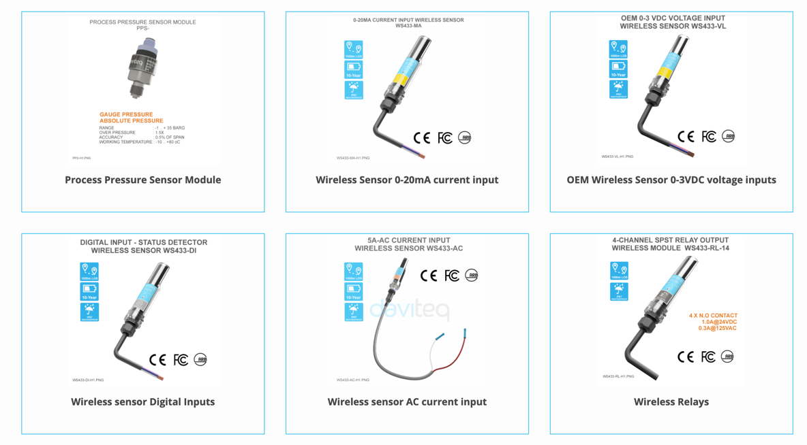
Daviteq Wireless Sub-GHz Sensors & Actuators
Confidential - Copyright by Daviteq - 2021
Notes:
CÁC LỢI ÍCH KHI KIỂM SOÁT TỐT NĂNG LƯỢNG

Slide 20
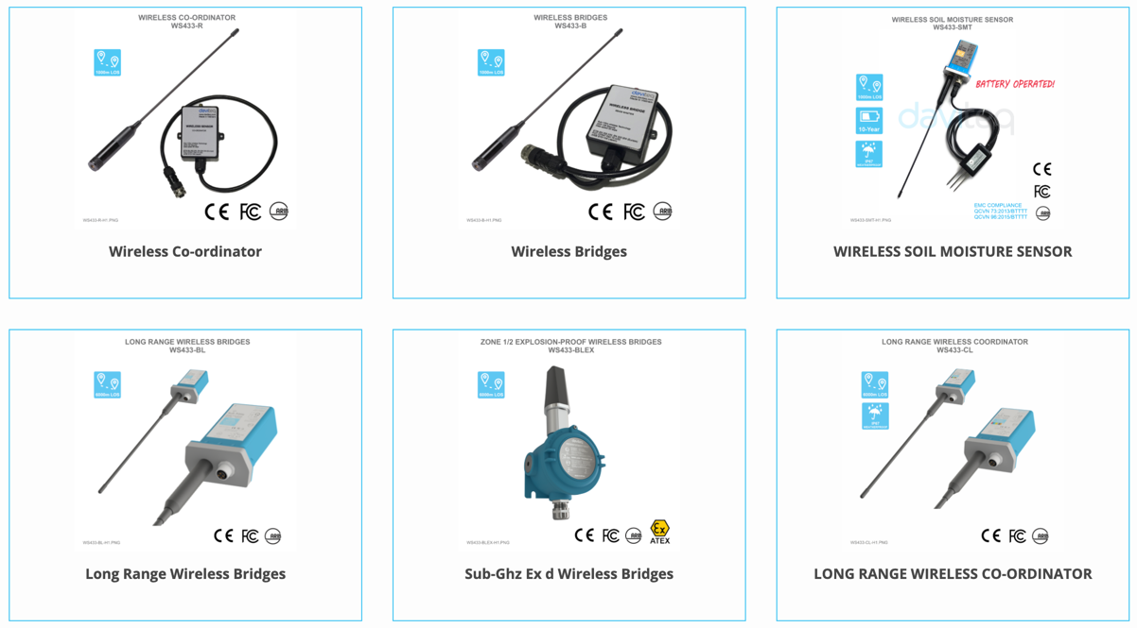
Daviteq Wireless Sub-GHz Sensors & Actuators
Click
here
for
More
info
Confidential - Copyright by Daviteq - 2021
Notes:
CÁC LỢI ÍCH KHI KIỂM SOÁT TỐT NĂNG LƯỢNG

Slide 21
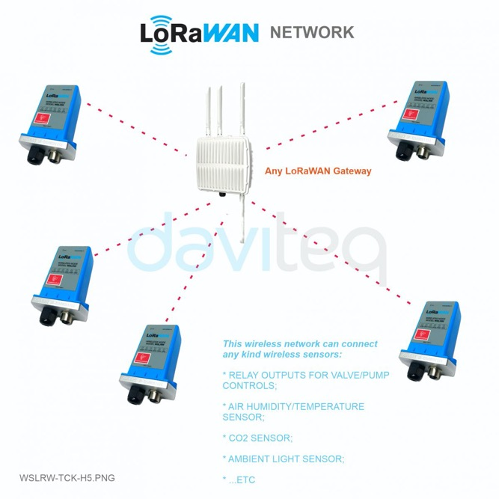
Daviteq LoRaWAN Sensors
Daviteq LoRaWAN Sensors
Very Long Distance communication
2-3 kms in urban or go through 8 floors
Up to 10-year Battery life
by popular AA battery Alkaline or Lithium
Strong functions
For Alarm processing, counting…
CE/RED/FCC Compliance Ready
to be certified soon
Many kinds of Sensors and I/O
Temperature, humidity, pressure, level, analog, digital, ambient ligth, vibration, gas sensor, liquid sensor…
Confidential - Copyright by Daviteq - 2021
Notes:
CÁC LỢI ÍCH KHI KIỂM SOÁT TỐT NĂNG LƯỢNG

Slide 22
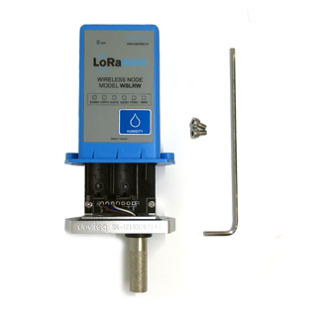
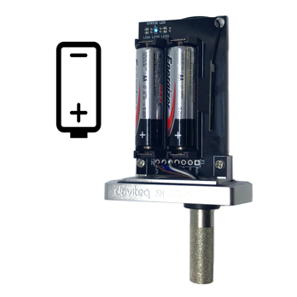
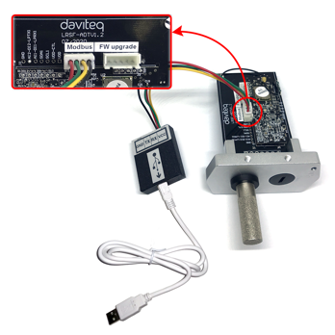
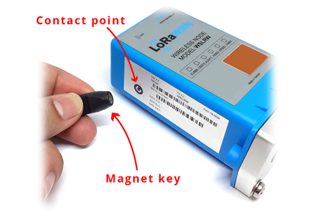
Daviteq LoRaWAN Sensors – Easy of Use
Configuration by Offline cable with free software
Manually triggering data sending by Magnetic key
Open 2 screws by Allen key
Insert 02 x AA batteries 1.5V
Confidential - Copyright by Daviteq - 2021
Notes:
CÁC LỢI ÍCH KHI KIỂM SOÁT TỐT NĂNG LƯỢNG

Slide 23
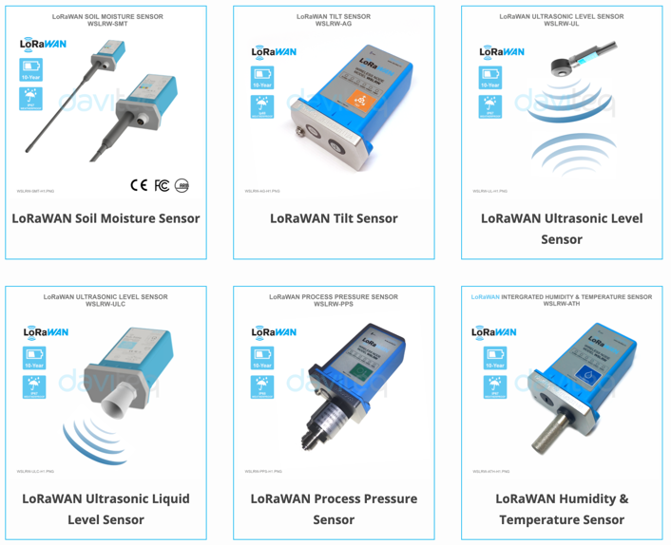
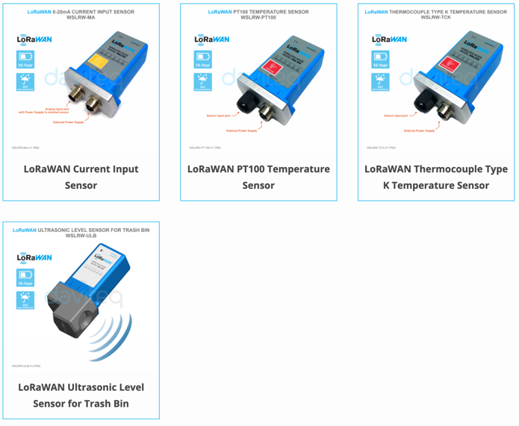
Daviteq LoRaWAN Sensors
and more ….
Click here for more info
Confidential - Copyright by Daviteq - 2021
Notes:
CÁC LỢI ÍCH KHI KIỂM SOÁT TỐT NĂNG LƯỢNG

Slide 24
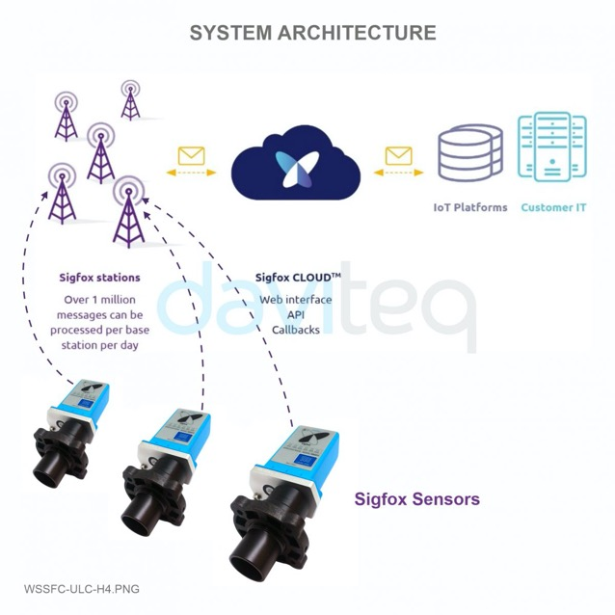
Daviteq Sigfox Sensors
Daviteq Sigfox Sensors
Very-very Long Distance communication
4-6 kms in urban or go through 12 floors
Up to 10-year Battery life
by popular AA battery Alkaline or Lithium
Strong functions
For Alarm processing, counting…
CE/RED/FCC Compliance Ready
to be certified soon
Many kinds of Sensors and I/O
Temperature, humidity, pressure, level, analog, digital, ambient ligth, vibration, gas sensor, liquid sensor…
Confidential - Copyright by Daviteq - 2021
Notes:
CÁC LỢI ÍCH KHI KIỂM SOÁT TỐT NĂNG LƯỢNG

Slide 25
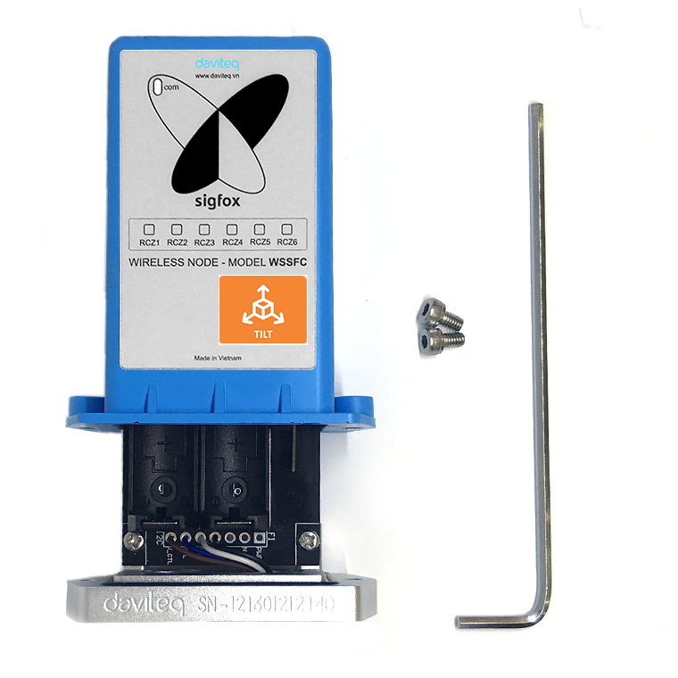
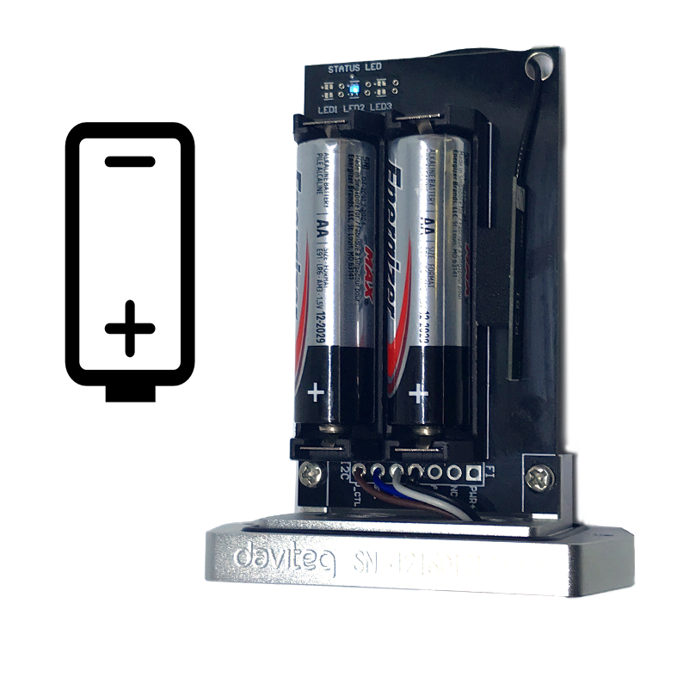
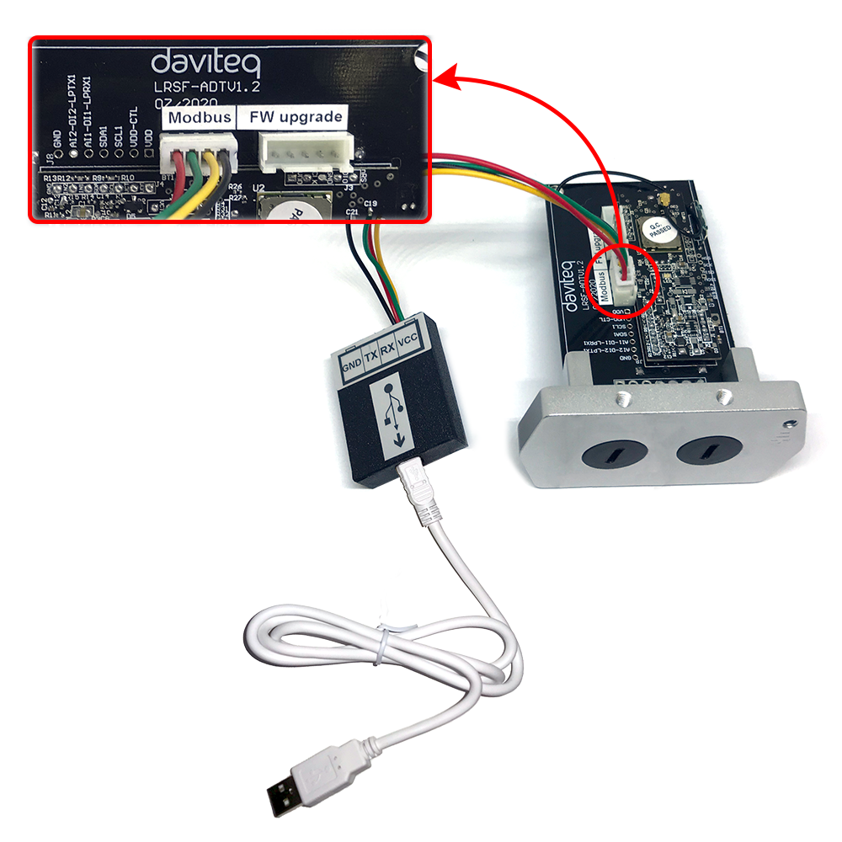
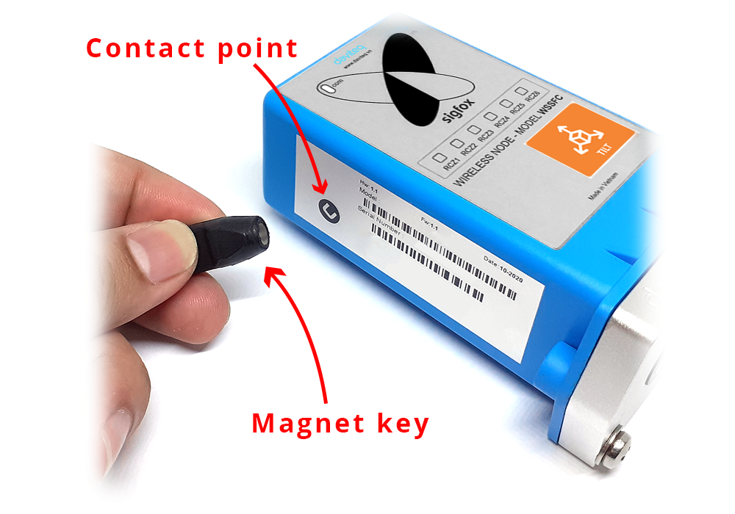
Daviteq Sigfox Sensors – Easy of Use
Configuration by Offline cable with free software
Manually triggering data sending by Magnetic key
Open 2 screws by Allen key
Insert 02 x AA batteries 1.5V
Confidential - Copyright by Daviteq - 2021
Notes:
CÁC LỢI ÍCH KHI KIỂM SOÁT TỐT NĂNG LƯỢNG

Slide 26
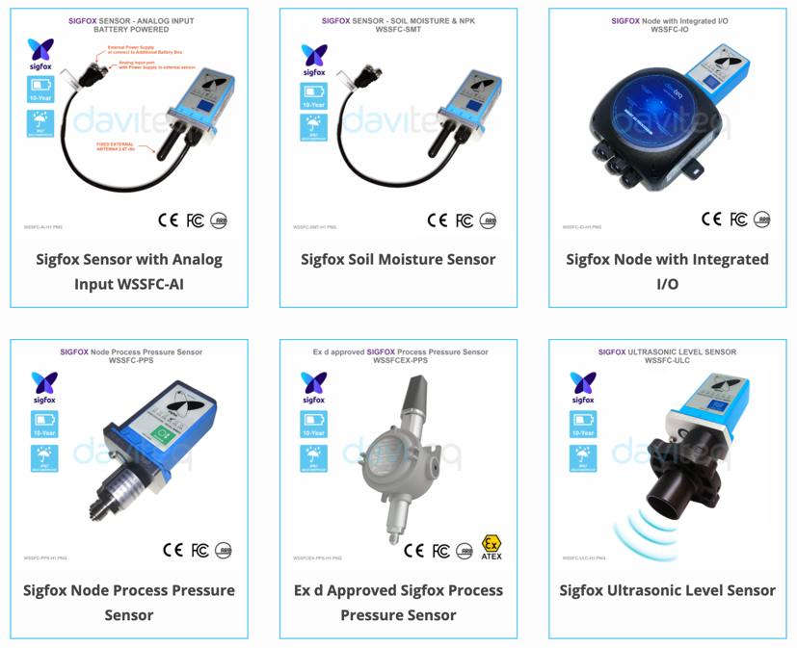
Daviteq Sigfox Sensors
and more ….
Click here for more info
Confidential - Copyright by Daviteq - 2021
Notes:
CÁC LỢI ÍCH KHI KIỂM SOÁT TỐT NĂNG LƯỢNG

Slide 27
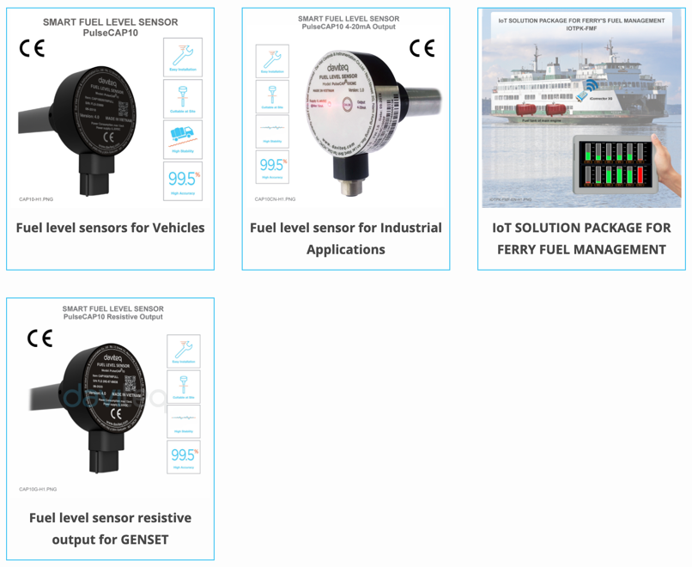
Daviteq Fuel Sensors & Fuel Monitoring
Daviteq Fuel Level Sensors
More than 50.000 sensors produced
Robust mechanical design
High stable measurement
Smart Firmware allows Auto-Calibration
Multiple output: 1-5VDC, RS232, 4-20mA, RS485…
CE Mark
Click here for more info
Confidential - Copyright by Daviteq - 2021
Notes:
CÁC LỢI ÍCH KHI KIỂM SOÁT TỐT NĂNG LƯỢNG

Slide 28
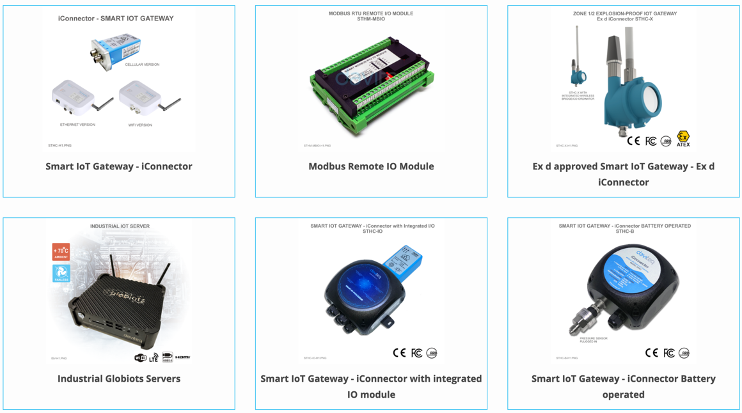
Daviteq IoT Products
and more ….
Click here for more info
Confidential - Copyright by Daviteq - 2021
Notes:
CÁC LỢI ÍCH KHI KIỂM SOÁT TỐT NĂNG LƯỢNG

Slide 29
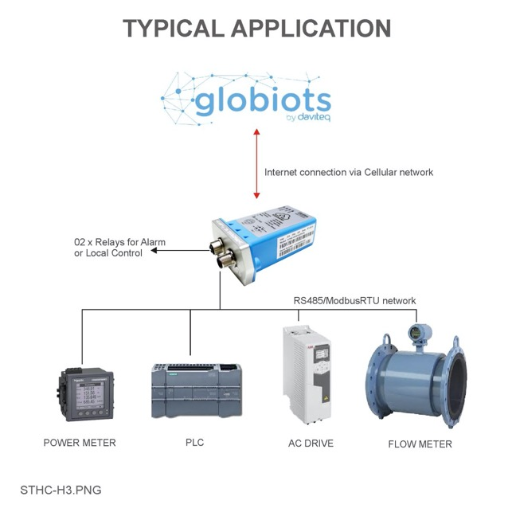
Daviteq IoT Products – Smart IoT Gateway
Daviteq Smart IoT Gateways
Robust Industrial Design IP67/68
for outdoor hash environment
Smart IoT Gateway
3-in-1, Data logger + Logic Controller + Gateway
Remote Activation/Configuration
via Globiots platform…
CE/RED/FCC Compliance Ready
to be certified soon
Support GPRS/3G/4G/NB-IoT/M1/WiFi/Ethernet
to suite different applications
Confidential - Copyright by Daviteq - 2021
Notes:
CÁC LỢI ÍCH KHI KIỂM SOÁT TỐT NĂNG LƯỢNG

Slide 30
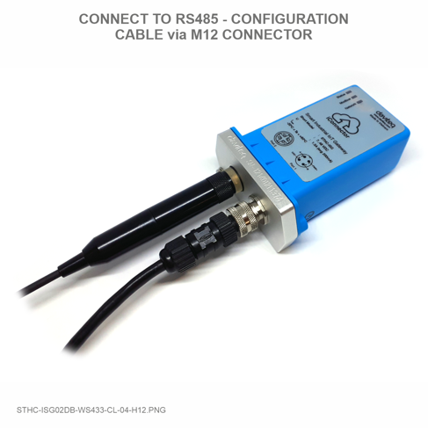
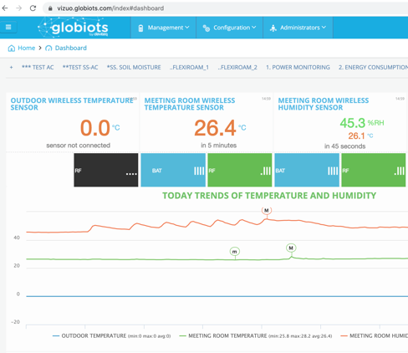
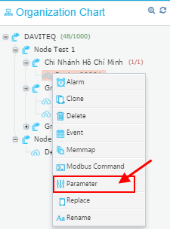
Smart IoT Gateway – Easy of Use
Offline configuration the Connectivity
Log in Globiots portal for
Activation
Configuration
Configuration for Dashboard / Report and start to use!
Confidential - Copyright by Daviteq - 2021
Notes:
CÁC LỢI ÍCH KHI KIỂM SOÁT TỐT NĂNG LƯỢNG

Slide 31
Daviteq IoT Products – Globiots Platform
Globiots is a Global Industrial Internet of Things Platform, developed by Daviteq since 2012, gained from 10-year experiences in Measurement & Controls;
Globiots platform allows customers easily connect their machine, process & people for Remote Management and Business Intelligent.
Globiots can be deployed and installed everywhere in the World. All Globiots clusters can be connected worldwide to form a distributed world-wide IoT system.
Confidential - Copyright by Daviteq - 2021
Notes:
CÁC LỢI ÍCH KHI KIỂM SOÁT TỐT NĂNG LƯỢNG

Slide 32
Daviteq IoT Products – Globiots Platform
Globiots system in On-premise Industrial Server
Globiots system on Cloud
OR
Confidential - Copyright by Daviteq - 2021
Notes:
CÁC LỢI ÍCH KHI KIỂM SOÁT TỐT NĂNG LƯỢNG

Slide 33
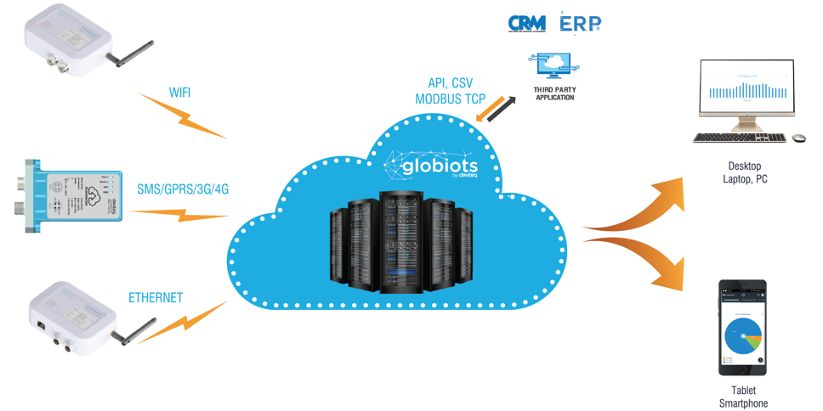
Daviteq IoT Products – Globiots Platform
SQL Server
BI Software
ERP
MES …
RestAPI
MQTT
SQL connection
CSV file Export
TXT file via FTP
Web Portal
Android
iOS
Mobile app
Confidential - Copyright by Daviteq - 2021
Notes:
CÁC LỢI ÍCH KHI KIỂM SOÁT TỐT NĂNG LƯỢNG

Slide 34
IoT Solutions
Power monitoring
Temperature and humidity monitoring
Machine operation monitoring
Machine performance monitoring
Refrigerated container monitoring
Fuel monitoring
Greenhouse monitoring
Hydroponics system monitoring
Corrosion monitoring for gas pipeline
Boiler monitoring
Server room monitoring
Confidential - Copyright by Daviteq - 2021
Notes:
CÁC LỢI ÍCH KHI KIỂM SOÁT TỐT NĂNG LƯỢNG

Slide 35
IoT Solutions
Pharmacy warehouse monitoring
Chiller monitoring
Generator set monitoring and control
Telecomunication station monitoring
Pump station remote monitoring and control
Waste air monitoring
Fire alarm system monitoring
Metal processing machine tool monitoring
Plastic extruder monitoring
Water monitoring in shirmp farm
Dry food silo monitoring and control
Confidential - Copyright by Daviteq - 2021
Notes:
CÁC LỢI ÍCH KHI KIỂM SOÁT TỐT NĂNG LƯỢNG

Slide 36
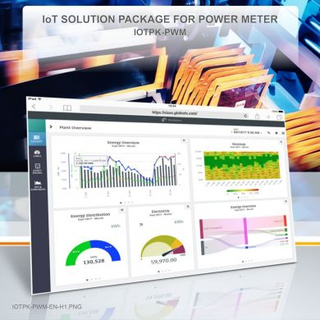
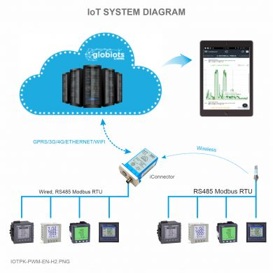
IoT Solution – Power Monitoring
Highlight Features
Various power meter type monitoring
Easy upgrade and expansion
Quick system deployment
Investment optimization
Optimized software
Applied Industries
Smart Factory
Smart Logistics
Smart City
Smart Agriculture
Smart Facility
Confidential - Copyright by Daviteq - 2021
Notes:
CÁC LỢI ÍCH KHI KIỂM SOÁT TỐT NĂNG LƯỢNG

Slide 37
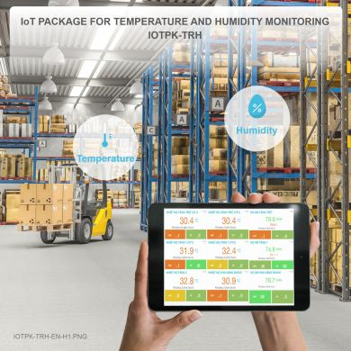
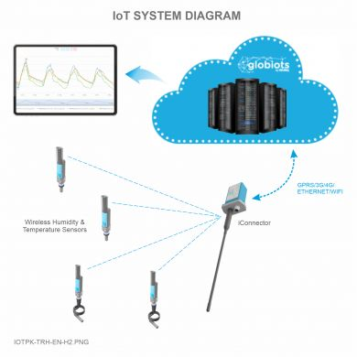
IoT Solution – Temperature&Humidity Monitoring
Highlight Features
True wireless sensor
Easy upgrade and expansion
Quick system deployment
Investment optimization
Easy system maintenance
Applied Industries
Smart Factory
Smart Logistics
Smart City
Smart Agriculture
Smart Facility
Confidential - Copyright by Daviteq - 2021
Notes:
CÁC LỢI ÍCH KHI KIỂM SOÁT TỐT NĂNG LƯỢNG

Slide 38


IoT Solution – Machine Operation Monitoring
Highlight Features
Various machine type monitoring
Easy upgrade and expansion
Quick system deployment
Investment optimization
Convenient system maintenance
Applied Industries
Smart Factory
Smart Logistics
Smart City
Smart Facility
Confidential - Copyright by Daviteq - 2021
Notes:
CÁC LỢI ÍCH KHI KIỂM SOÁT TỐT NĂNG LƯỢNG

Slide 39


IoT Solution – Machine Performance Monitoring
Highlight Features
Various machine type monitoring
Easy upgrade and expansion
Quick system deployment
Investment optimization
Customized and specialized software
Applied Industries
Smart Factory
Smart Logistics
Smart City
Smart Facility
Confidential - Copyright by Daviteq - 2021
Notes:
CÁC LỢI ÍCH KHI KIỂM SOÁT TỐT NĂNG LƯỢNG

Slide 40


IoT Solution – Refrigerated Container Monitoring
Highlight Features
Anywhere, anytime monitoring
Easy upgrade and expansion
Quick system deployment
Investment optimization
Customized and specialized software
Convenient data exchange
Applied Industries
Smart Logistics
Smart City
Smart Agriculture
Confidential - Copyright by Daviteq - 2021
Notes:
CÁC LỢI ÍCH KHI KIỂM SOÁT TỐT NĂNG LƯỢNG

Slide 41


IoT Solution – Fuel Monitoring
Highlight Features
Anywhere, anytime monitoring
Easy upgrade and expansion
Quick system deployment
Investment optimization
Customized and specialized software
Convenient data exchange
Applied Industries
Smart Factory
Smart Logistics
Smart City
Smart Facility
Confidential - Copyright by Daviteq - 2021
Notes:
CÁC LỢI ÍCH KHI KIỂM SOÁT TỐT NĂNG LƯỢNG

Slide 42


IoT Solution – Greenhouse Monitoring
Highlight Features
Anywhere, anytime monitoring
True wireless sensor
Easy upgrade and expansion
Quick system deployment
Investment optimization
Fast system maintenance
Applied Industries
Smart City
Smart Agriculture
Smart Facility
Confidential - Copyright by Daviteq - 2021
Notes:
CÁC LỢI ÍCH KHI KIỂM SOÁT TỐT NĂNG LƯỢNG

Slide 43


IoT Solution – Hydroponics System Monitoring
Highlight Features
Anywhere, anytime monitoring
True wireless sensor
Easy upgrade and expansion
Quick system deployment
Investment optimization
Fast system maintenance
Applied Industries
Smart City
Smart Agriculture
Confidential - Copyright by Daviteq - 2021
Notes:
CÁC LỢI ÍCH KHI KIỂM SOÁT TỐT NĂNG LƯỢNG

Slide 44


IoT Solution – Server Room Monitoring
Highlight Features
Real time 24/7 monitoring
Available API for 3rd party software
Automatic alarm notification
Optimized and flexible investment
30-minute installation
Customized functions and reports
“True wireless” system, max 1000m
Easy upgrade and expansion
Applied Industries
Smart Facility
Confidential - Copyright by Daviteq - 2021
Notes:
CÁC LỢI ÍCH KHI KIỂM SOÁT TỐT NĂNG LƯỢNG

Slide 45

IoT Solution–Pharmacy Warehouse Monitoring
Highlight Features
Real time 24/7 monitoring
Available API for 3rd party software
Automatic alarm notification
Optimized and flexible investment
30-minute installation
Customized functions and reports
“True wireless” system, max 1000m
Easy upgrade and expansion
Applied Industries
Smart Logistics
Smart Facility
Confidential - Copyright by Daviteq - 2021
Notes:
CÁC LỢI ÍCH KHI KIỂM SOÁT TỐT NĂNG LƯỢNG

Slide 46


Some Case studies
Confidential - Copyright by Daviteq - 2021

Slide 47


Some Case studies
Confidential - Copyright by Daviteq - 2021

Slide 48


















Some customers in Vietnam
Garments
Confidential - Copyright by Daviteq - 2021

Slide 49

















Some customers in Vietnam
Contractors
Energy Audit Companies
Confidential - Copyright by Daviteq - 2021

Slide 50













Some customers in Vietnam
Food & Beverages
Stock Feed
Logistics
Emission Monitoring
Health
Confidential - Copyright by Daviteq - 2021

Slide 51









Some customers in Vietnam
Machining
Plastic injection & extruding
Cements
Equipment Makers
Telecomunication
Confidential - Copyright by Daviteq - 2021

Slide 52





Some customers in Vietnam
Energy/Utility
SolarFarm
Properties Management
Oil & Gas
Steels
Confidential - Copyright by Daviteq - 2021

Slide 53








International IoT Solution Partners Network
Autralia and New Zealand | Temperature Monitoring Solutions for Food, Pharmaceutical…IoT Solutions Provider | Malaysia | Data center Environment Monitoring Solutions Smart Chili Farm Smart Durian Farm Smart Hydroponics Farm…
Singapore | Smart Facility Solutions Smart City Solutions Smart Solar System | Malaysia | Sigfox operator in Malaysia Smart City Solutions Smart Facility Solutions Smart Agriculture Solutions …
Singapore | Factory Automation Process Automation Smart City Solutions Smart Facility Solutions | Malaysia | Smart Factory Solutions Smart Facility Solutions Smart City Solutions Smart Agriculture Solutions
Singapore | Smart Factory Solutions Smart Facility Solutions Smart City Solutions | Nosairis - Malaysia | Smart City Solutions Smart Facility Solutions Smart Agriculture Solutions
Confidential - Copyright by Daviteq - 2021

Slide 54







International IoT Solution Partners Network
Thailand | Smart Factory Solutions Smart Facility Solutions Smart City Solutions Smart Agriculture Solutions | Malaysia | Mobile Network Operator with International roaming sim card Smart City Solutions Smart Facility Solutions Smart Agriculture Solutions
Thailand | Smart Factory Solutions Smart Facility Solutions Smart City Solutions Smart Agriculture Solutions | South Africa | Smart City Solutions Smart Facility Solutions Smart Agriculture Solutions …
India | Smart City Solutions Smart Facility Solutions Smart Agriculture Solutions | United King dom | Power Meter Manufacturer Energy Monitoring Solutions
India | CEMS monitoring equipment and solutions | Norway | Mobile Network Operator Smart City Solutions Smart Facility Solutions Smart Agriculture Solutions
Confidential - Copyright by Daviteq - 2021

Slide 55








Vietnam IoT Solution Partners Network
 | Hydroponic Farm Solutions Mushroom Farm Solutions Bird Nest House Solutions |  | Data center Environment Monitoring Solutions
 | Automation, IoT, IIoT Condition Monitoring, Preventive Maintenance |  | HVAC Solutions
 | Smart City Solutions MAP4D for Smart Nation |  | Waste Water Monitoring Water Well Monitoring
 | Smart Factory Solutions ERP Solutions MES Solutions |  | Smart Factory Solutions ERP Solutions MES Solutions
Confidential - Copyright by Daviteq - 2021

